Slide 1
Timeline
Klaudia Biczysko
Justyna Sikora

Slide 2
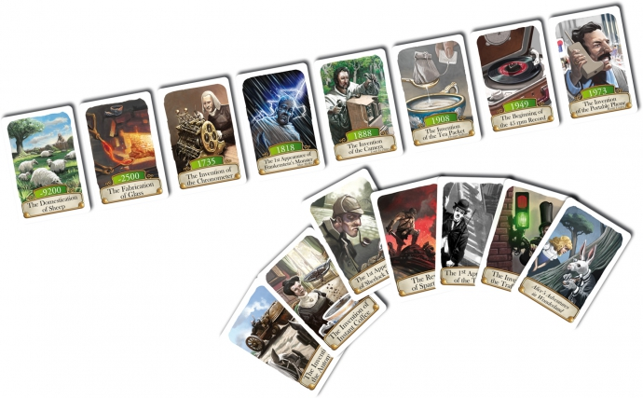
The game – what does it do?
Notes:
Our game is based on the card game with the same name.
The gamer gets a year and needs to decide if the presented discovery/invention happened before or after.

Slide 3
Question
Correct answer:
Player gets 1 point and another question
Wrong answer:
Player gets a „last chance question”
Correct answer :
Player gets 0,5 point and another question
Wrong answer – the game ends
Game ends when player gets 5 points
Notes:
If user answers correctly, he scores a point and needs to decide
if another invention happened before or after the one which was presented beforehand.
If user's answer is wrong, he gets one more question and needs to decide which answer
out of three is the correct one.
If he answers correctly, he does get a half of point and
continue the game. If user cannot answer the second question, he loses.
The round consists of 5 basic questions. If user answers correctly to each of them, he wins the round.
All inventions happened in XIX and XX century.

Slide 4
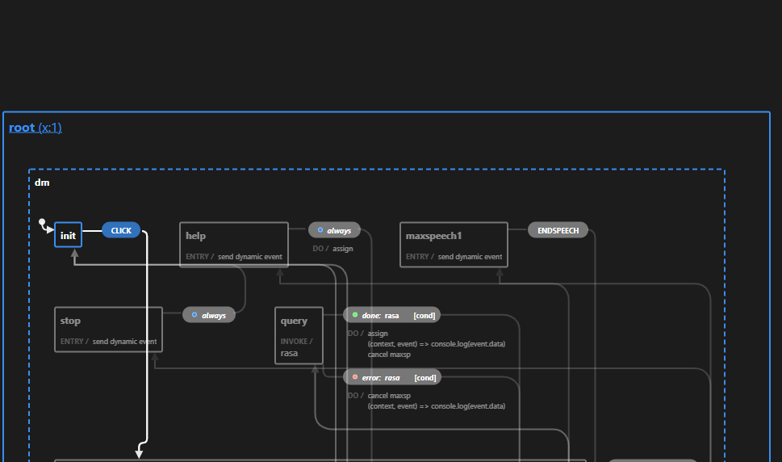
Technicalities and challenges
Notes:
One of our main challenges was how the program read years. Since it is being read as a normal number,
not as a year. To be able to compare, we had to leave it out.
We had also problems with the intent classification. When we said something like "wash the dishes",
it was recognized as "after" with 99% accuracy.
But we managed to fix that by adding that if the entity is not one of the intents 'before' or 'after',
it says that the answer is not valid and asks the question once again.

Slide 5




Relation to course contents

Slide 6
Future work: how could the game be developed?
Multiplayer
Bigger database
Different extensions/modes
Notes:
When it comes to the design, the mentioned year could be visible in the application.
What's more, there could be a
link to f.ex. Wikipedia article,
where user could read more about the event.
The database of questions could be much bigger and have questions about different centuries,
not only about XIX and XX. It would be also interesting to have several difficulty levels, f.ex.
a beginner could have more time to answer the question.
Also the game could be played by more than one player.
Every question would be for a different player and the game would remember, whose turn it is.

Slide 7
